Slide 1


Advanced Analytics Ranking System Dashboard
In partnership with MQE | UCLA
David Ma, Edith Liu, Kevin Zhao and Amanda Wei

Slide 2
Our Team Infographics
Director
Director
David Ma
Amanda Wei
1st Year MQE student
Transformer model fine tuning
1st year MQE student
Metrics identification & Dune queries
Assistant
HR Manager
Kevin Zhao
Edith Liu
1st year MQE student
Data collecting & processing
1st year MQE student
Constructing the dashboard

Slide 3
Agenda
Background information
Rank select system
Metrics breakdown
Data approach
Model construction
Modeling results and showcase
Conclusion and takeaways

Slide 4
Background
Cryptocurrency:
Cryptography based on blockchain
Decentralized Nature
Digital Format
Peer to peer transactions
DeFi → Decentralized Finance:
Based on cryptocurrency
Financial application of cryptocurrency
Accessible financial network without a center
Transparency but Risk
Protocols
The backbone of the cryptocurrency and DeFi
Foundational software rules and structures designed to facilitate specific types of transactions or interactions on the blockchain

Slide 5

Overview
Rank Select Module:
A robust tool that will employ a multi-layered approach
Assess and identify across the main crypto niches and ecosystems in Web3
Various metrics go through multiple layers before receiving the final filter anchored in the scorecard
An open source project help user on token selections.
Main focus:
developing an adaptable data infrastructure
provide well-organized datasets to different users in this field

Slide 6
What makes the “Rank Select” tool relevant?
“DYOR”: Do Your Own Research
A concept of investigating
In Financial industry, but it also works here in the field of crypto
The usual process of delving into the crypto field, especially if DeFi, requires investors to:
Understand the fundamentals
Research the projects' background
Do technical due diligence
Evaluate Performance and Risks
However, this is hard to do!
Reason: crypto is really technical
Solution? Rank Select System!
Provide a straightforward tool to determine the quality of projects
Time savior and dependable investment advice

Slide 7
Methodology
Identify relevant metrics
Data collection
Rank-Select model construction
Visualization via Streamlit

Slide 8
Breakdown of Metrics
TVL (Total Value Locked):
The total value of all assets deposited in a DeFi protocol.
A high TVL indicates that many users trust and use the protocol, suggesting its popularity and stability. It's a sign of the protocol's ability to secure user funds
Fee:
The charges users pay to perform transactions or other operations within a protocol.
Fees can reflect the utility and demand for a protocol. High fees might indicate high demand, but if too high, they could deter users. A balance is key for long-term sustainability.

Slide 9
Breakdown of Metrics
APY (Annual Percentage Yield):
The rate of return earned on an investment over a year, taking into account the effect of compounding interest.
APY is crucial for investors seeking passive income from staking or liquidity provision. High APY can attract more investments, but it's important to assess the risk and sustainability of high returns.
Trading Volume:
The total amount of the asset traded in a given period.
High trade volume indicates a healthy level of activity and liquidity, making it easier for users to enter or exit positions. It can also signal investor interest and a vibrant market.

Slide 10
Methodology
Identify relevant metric
Data collection
Extracting
Combining
Cleaning
Aggregating
Rank-Select model construction
Visualization via Streamlit
Notes:
Our Data collection process includes 4 main steps
I will walk through each of them in next couple of slides

Slide 11
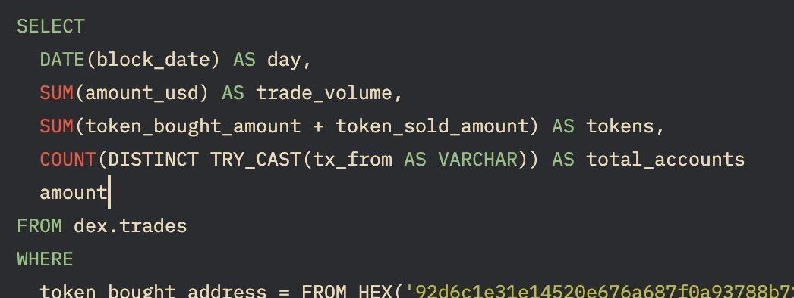
Data Approach
Extracting Data:
Data for different metrics such as supply, TVL, fees, and yields are extracted from
Defi Llama API
Dune Analytics query
Notes:
DeFi Llama is a comprehensive analytics platform dedicated to tracking the decentralized finance sector across multiple blockchains.
Dune Analytics has an advanced query functionality, which allows users to directly interact with blockchain data through SQL queries.
Problem 1: most of the queries on the platform only cover one matrics for one protocol, the searching process is very time consuming
Problem 2: existed queries not available/data missing/file damaged/doesn’t have the up to date data.
Solution: we created our own queries using SQL to fetch data directly from it’s database, here is a example of a simple query we wrote to fetch trade volume for dydx. For some other protocols, the query can be much more complicated
and we also tried to group the protocol from the same category together to enhance efficiency
On top the previous applied project teams, we have added 15 new protocols from DefiLlima’s top 100 list, as well as 4 new matrices to help predict future TVL.
Credit to our approach of using self created queries, we were able to fill out a lot of missing data from the previous groups

Slide 12
Data Approach
Combining Data:
Different metrics for each protocol are combined into a single dataframe.
Notes:
Data for each matric were retrieved individually, we constructed a pandas dataframe to combine all matric together for the same protocol

Slide 13
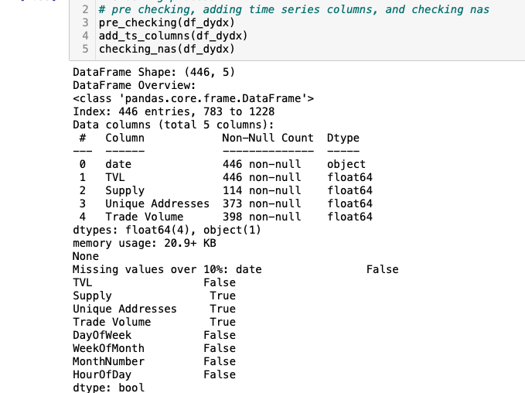
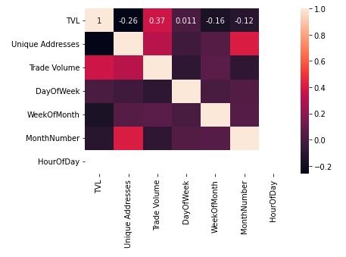
Data Approach
Cleaning Data:
Initial preprocessing includes checking for time frame, missing values and multicollinearity
Further cleaning involves handling missing values, outliers and removing duplicates.
Notes:
Preliminary checking process
Trim out data before 1/1/2023, and make sure all dates were set in the correct format for future time series forecasting
Identify for missing data, if any matric has over 10% missing observation, we are going to drop the entire column
Check for multicollinearity by drawing out heat maps
Data cleaning
We write functions to fill out missing value, drop outliers and duplicates

Slide 14
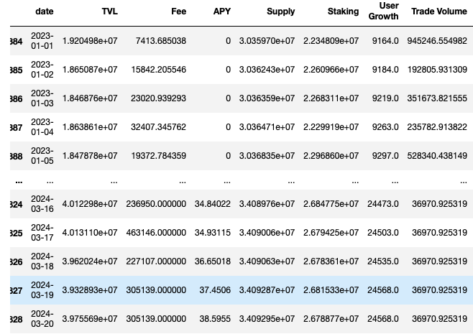
Data Approach
Aggregating Data:
Finally, cleaned dataframes for each protocol are aggregated into a main structure which is then used for the Rank-Select model.

Slide 15
Rank-Select Model
Identify relevant metrics
Data collection
Rank-Select model construction
Create a Transformer model (neural network architecture) using torch.nn module
Train the model, make predictions, and calculate RMSE/Score
Rank the protocols
Visualization via Streamlit
Notes:
Another area that we made progress on top of the previous applied project teams
We build a transformer model using PyTorch's neural network module, which is commonly used for time series forecasting
The training loop involves feeding batches of data to the model, calculating the loss, and updating the model's weights accordingly.
Then we make predictions on each protocol’s TVL and calculate RMSE and the rank select score
A higher score indicates that the protocol has a good track record and has lower risk to invest in it
Rank the protocols base on score
The mission of our project is to help investors streamline their research process in the Defi Space. For an easier visualization, we also created a dashboard using python’s Streamlit library.

Slide 16
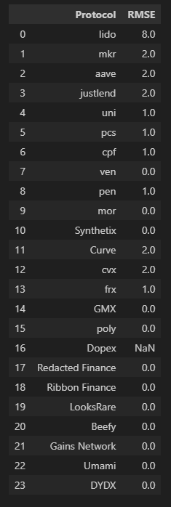
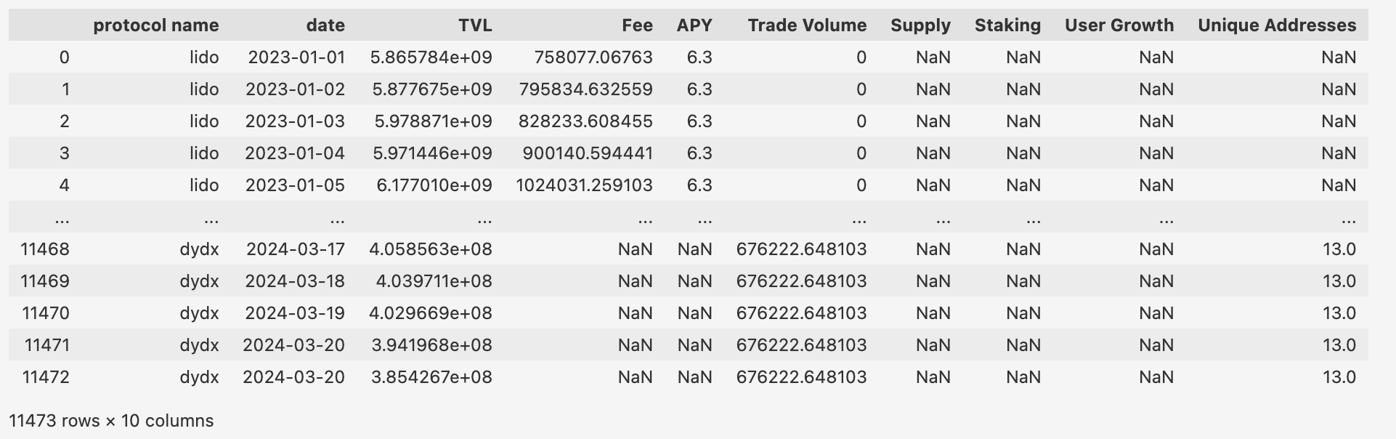
Modeling results
Main Structure - 25 protocols, 8 metrics, data from last 2 years.
+
Transformer Model to calculate RMSE for each protocol.

Slide 17
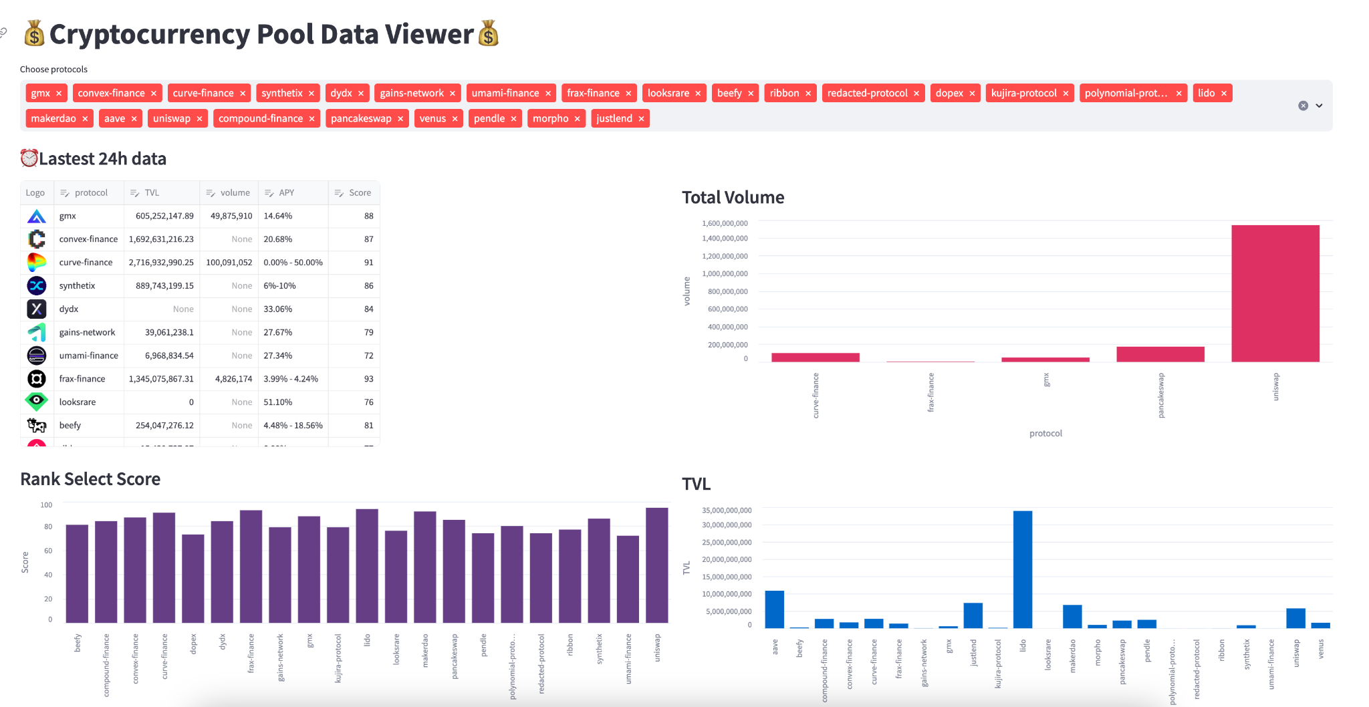
Rank Select Module Showcase
Protocols Selectors
Rank Select
Score
Total volume
Latest 24h Data
Rank Select Score
TVL

Slide 18
Improvements in the future
Missing values, limited available data from open sources database
More metrics that have significant weights
More dimensions to calculate rank select score
Robustness of the model

Slide 19
Conclusions and Key Takeaways
Collected data for 25 Defi protocols as well as 8 metrics for each of them, obtained a total of 11473 inputs
Applied deep learning framework, and constructed a transformer model for rank select
Created a interactive and user-friendly “Cryptocurrency Pool Data Viewer” to visualize the score card
Enhanced understanding of Crypto and DeFi space
Refined skills on data extraction, analysis, and visualization
Learned how to build models for time series forecasting

Slide 20
Thank you for your listening

Slide 21




Whitepaper
info@7vfi.ai
#WAGMI 🚀

